Slide 1
Percent Composition

Slide 2
Calculating Percent Composition
Sometimes it is important to know the relative amounts of the components of compounds and mixtures.
One situation where this becomes important is after synthesizing a new compound. Its formula must be determined.
The first step – find the relative amounts of each element of the compound – the percent composition by mass of the compound.

Slide 3
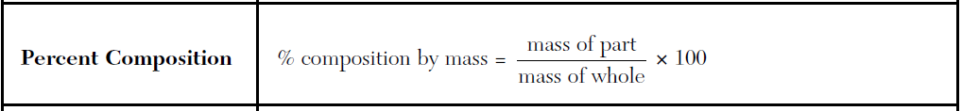
A sample of a substance containing only magnesium and chlorine was tested in the laboratory and was found to be composed of 74.5% chlorine by mass. If the total mass of the sample was 190.2 grams, what was the mass of the magnesium?

Slide 4
What is the percent by mass of oxygen in magnesium oxide, MgO?
Find molar mass (mass of whole); divide the mass of the element you are looking for by the molar mass.

Slide 5
The percent by mass of carbon in HC₂H₃O₂ is equal to…?
The % by mass of oxygen in ethanoic acid is???

Slide 6
Hydrates
Water is a highly polar molecule – it has some ionic character, and is often found in ionic compounds
Examples include:
Gypsum (drywall) CaSO₄●2H₂O
Epsom salts MgSO₄ ●7H₂O
When heated, the water evaporates from the crystal, leaving the anhydrous form of the crystal:

Slide 7
Hydrates Decompose When Heated
CaSO₄●2H₂O (s) + heat 🡪 CaSO₄(s) + 2H₂O (g)
Calcium sulfate dihydrate anhydrous calcium sulfate
MgSO₄●7H₂O (s) + heat 🡪 MgSO₄(s) + 7H₂O (g)
magnesium sulfate heptahydrate anhydrous magnesium sulfate

Slide 8
A hydrate is a compound that includes water molecules within its crystal structure. During an experiment to determine the percent by mass of water in a hydrated crystal, a student found the mass of the hydrated crystal to be 4.10 grams. After heating to constant mass, the mass was 3.70 grams. What is the percent by mass of water in this crystal?

Slide 9
HW: Calculate % by mass for each element
AgCN name__________________ | FeSO₄ name _________________
CCl₄ name __________________ | CaBr₂ name __________________

Slide 10
Mg(OH)₂ name_________________ | NO₂ name ___________________
Al₂O₃ Name __________________ | SF₆ __________________________

Slide 11
Lab 10:Water Of Hydration Of A Crystal
You are to determine experimentally the number of water molecules (n) in a crystal of CuSO₄•nH₂O.
To find n, you will heat a known mass of the hydrate to drive off the water.
The crystals will become powdery and lose their deep blue color. You can then determine the mass of water present per mass of crystal.

Slide 12
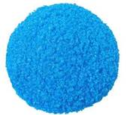
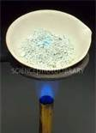
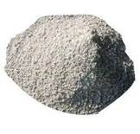
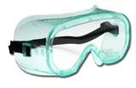
🡪
🡪
CuSO₄•nH₂O + heat 🡪 CuSO₄ + nH₂O
A must at all times!!!!

Slide 13
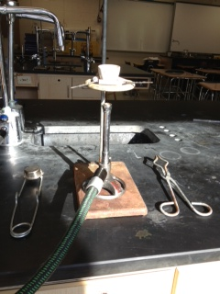
Materials
crucible
crucible tongs
pipestem triangle
ringstand
bunsen burner
striker
balance

Slide 14
Hazards Associated With Copper Sulfate
Eye: Exposure to particulates or solution may cause conjunctivitis, ulceration, and corneal abnormalities.
Causes eye irritation and possible burns.
Skin: May cause skin sensitization, an allergic reaction, which becomes evident upon re-exposure to this material.
Causes skin irritation and possible burns. May cause itching eczema.

Slide 15
More Hazards
Ingestion: Harmful if swallowed. May cause severe gastrointestinal tract irritation with nausea, vomiting and possible burns.
Ingestion of large amounts of copper salts may cause bloody stools and vomit, low blood pressure, jaundice and coma.
Ingestion of copper compounds may produce systemic toxic effects to the kidney and liver and central nervous excitation followed by depression.
Inhalation: May cause ulceration and perforation of the nasal septum if inhaled in excessive quantities.
Causes respiratory tract irritation with possible burns.

Slide 16
If you have a problem:
Eyes: Immediately flush eyes with plenty of water for at least 15 minutes, occasionally lifting the upper and lower eyelids. Get medical aid.
Skin: Get medical aid.
Flush skin with plenty of soap and water for at least 15 minutes while removing contaminated clothing and shoes.
Wash clothing before reuse.

Slide 17
Ingestion: Do NOT induce vomiting. If victim is conscious and alert, give 2-4 cupfulls of milk or water.
Never give anything by mouth to an unconscious person. Get medical aid immediately.
Inhalation: Remove from exposure to fresh air immediately.
If breathing is difficult, give oxygen. Get medical aid.
Do NOT use mouth-to-mouth resuscitation. If breathing has ceased apply artificial respiration using oxygen and a suitable mechanical device such as a bag and a mask.

Slide 18
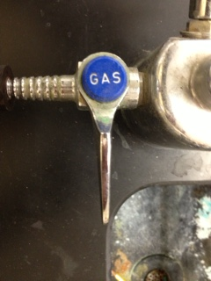
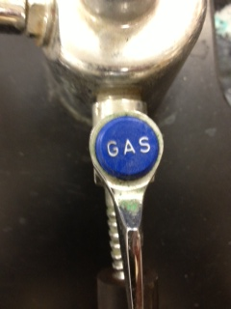
Using the Bunsen Burner
The gas (propane, C₃H₈) is controlled by several valves.
Perpendicular to nozzle: closed
Parallel to nozzle: fully open!

Slide 19
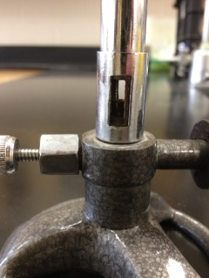
Bunsen Burner Valve
There is a screw valve on the burner. This should always be closed when opening the sink valve.
To turn close this valve, turn it clockwise.

Slide 20
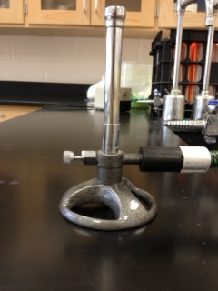
Air Intake Valve
The shaft of the burner has an air intake valve.
This valve needs to be fully open for complete combustion to occur.

Slide 21
Hazards of Incomplete Combustion
When enough oxygen is present in the gas mix
C₃H₈ + O₂ 🡪 CO₂ + H₂O
When not enough oxygen is available, carbon monoxide and soot (elemental carbon) are produced along with carbon dioxide and water.
Carbon monoxide is poisonous – keep the air intake valve open!!

Slide 22
Procedure
Mass a clean, dry crucible to the nearest 0.01 gram and enter on the data sheet.
Add approximately 5 grams of Copper Sulfate (hydrate) to the crucible and remass. Enter mass on data sheet.
Place the crucible in a pipestem triangle on the ringstand and heat it, gently at first, until it becomes powdery.
Allow to cool and remass. Enter mass on data sheet. To be sure that all the water has been driven off, the crucible must be heated, cooled and remassed until the mass remains constant (it loses no more mass).
Never mass hot objects. Hot objects may ruin the balance and will not give accurate results.

Slide 23
Lighting the burner
Make sure all both gas valves are closed, and the air intake valve on the burner is open.
Open the sink gas valve, turning it from perpendicular to parallel.
Open the burner gas valve a half a turn.
Place the striker over the burner, and grind the flint to make a spark.

Slide 24
Data Table
1. Mass of the empty crucible _________________
2. Mass of the crucible & hydrate ________________
3. Mass of the hydrate (2-1) _____________________
4. Mass of the crucible & anhydrous powder ______ *______ *______
5. Mass of the anhydrous powder (4-1) ______________
6. Mass of the water(2-4) ________ *_______ *________
*Repeat Step 4 in Procedures until data on mass of the water is constant.

Slide 25
% Water Calculations
Calculate the % H₂O in hydrated copper sulfate: (step 6/step 3)*100

Slide 26
Molar Mass Calculations
Calculate the molar mass of anhydrous copper (II) sulfate below. Show your work.
Calculate the gram formula mass of water below. Show your work.

Slide 27
Moles of CuSO₄ and H₂O
Calculate the number of moles of water and the number of moles of anhydrous copper (II) sulfate in the boxes below.

Slide 28
Calculate the number of water molecules per copper (II) sulfate from your results in question 4:
the number of moles of H₂O
the number of moles of CuSO₄

Slide 29
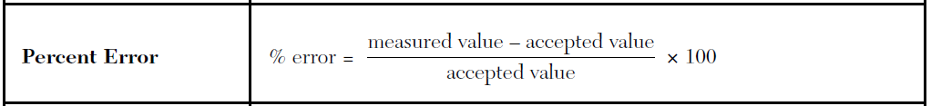
Conclusions
The accepted value for the number of water molecules in this compound is five (CuSO₄ *5 H₂O). Calculate the % error for your measurement.

Slide 30
Conclusions
Give at least two possible sources of error for this experiment.
Write a balanced chemical equation for this experiment. What type of chemical reaction is this?

